Slide 2
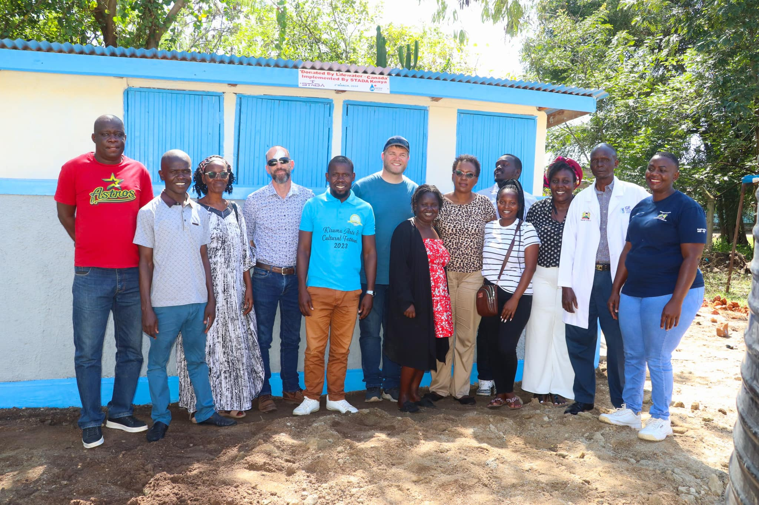
DEPARTMENTAL MONTHLY REVIEW MEETING 5TH APRIL, 2024

Slide 3
PROJECT OVERVIEW
VISION:
“A community where girls and women have access to all basic human rights”
MISSION:
“To promote Community health, Gender equality, Education and human rights among girls and women through Evidence-based advocacy, Community empowerment, Capacity building, Social protection and Collaboration”
CORE VALUES
Feminism: We believe everyone should have access to equal opportunity
Inclusion: We involve and engage everyone in all our undertaking without leaving anyone behind.
Excellence: We do our work with professionalism to sustain standards effectively and efficiently
Dignity: We treat everyone with care and respect in all our undertaking
Accountability: We take ownership of our work, stay on track with our goals and achieve success across the organization.

Slide 4
DEPARTMENTS/PROGRAMS
Health Department
Gender Department
Water, Sanitation and Hygiene (WASH) department
Education Department
Humanitarian Department
Textile department
Advocacy and Communication Department
Procurement Department
Information, Communication and Technology department
Monitoring and evaluation Department
Finance Department
Administration

Slide 5
HEALTH DEPARTMENT
In March, the department conducted the following activities:
Community Dialogues in Kabar Central, Kadete and Ogenya
Serenity Seekers school clubs’ outreaches.
Grant writing: Water Development project, Loss and Damage Project and Better World Book literacy grant.
International Women’s Day and World Water Day celebrations at Kibarwa Evacuation Centre and Rongo Primary, respectively.
Attended a 2 Day WKSP Menstrual Products Certification Workshop with KEBS

Slide 6
GENDER DEPARTMENT
In March, the following activities were conducted by the department:
Community dialogue at Kabar Central and Masogo to discuss GBV: root causes, impacts of GBV, preventive strategies, barriers to reporting pathways, support and services for survivors, engagement of men and boys and collective actions/ ways forward.
Commemorated International Women’s Day at Kibarwa evacuation center with women from Kandaria and Kabonyo Fisheries, highlighting the consequences of climate change and promoting women's economic empowerment.
Celebrated World Water Day at Rongo Comprehensive School.
Case documentation in Migingo Comprehensive School, Alendu and Nyando Law Court.
Teen moms’ engagement: Kobura, Ogenya and Nyabondo.

Slide 7
CONT…
School outreach on Serenity Seekers club, we engaged with students from Rabuor Comprehensive School on Mental health and GBV awareness creation.
Grant writing on: The IHE Delft’s Water and Development Partnership Programme (initial project idea). We based the grant on curriculum development on pump training and repair, Grant Cycle for Youth-led Organizations working on Climate Change, loss and damage which was based on Ogenya IDP camp relocation and resettlement and Better World Books Literacy Grant.
Feminist Movement Building, follow-up meetings on the cash transfer were held to track project progress and impacts, as well as to explore group registration for certification purposes.

Slide 8
WATER, SANITATION AND HYGIENE DEPARTMENT
In March, the number of drilled boreholes, rehabilitated and repaired pumps, alongside health and hygiene talks that were provided were as follows:
The department also participated in the commemoration of the World Water Day at Rongo Comprehensive School, and the International Women’s Day at Kibarwa Evacuation Centre.
Drilled boreholes | Rehabilitated pumps | Repaired pumps | Health and hygiene talks | Total activities
11 | 1 | 100 | 83 | 195

Slide 9
EDUCATION DEPARTMENT
In March, minimal activities were conducted in the library, since it is still under renovation, awaiting the learners. However, the department conducted the following activities:
Research on the Competency-Based Curriculum {CBC} Education System and on compulsory subjects for early-year education (pre-primary and lower primary) and middle school (upper primary and lower secondary)
Participated in grant writing on Water and Development Partnership program, Better World Book 2024 Literacy and Grant Cycle {Climate Change}.
Organized a meeting with the education department to talk about this term's library goals and activities.
Conducted a learning session at the community library.

Slide 10
CONT….
Gained parental consent to let kids visit the library over the April holiday through parents’ mobilization.
Participated in the International Women's Day, and World Water Day celebrations at Kibarwa Evacuation Centre and Rongo Comprehensive School respectively.

Slide 11
HUMANITARIAN DEPARTMENT
In March, the department collaborated with the Gender department in celebrating the International Women’s Day, that was held at Kibarwa Evacuation Centre, Kabonyo Kanyagwal. Food items were also donated to the displaced women, as a way of giving back to the community. The department also worked alongside the education department to celebrate the World Water Day at Rongo Comprehensive School, whose theme was “Water for Peace”.

Slide 12
TEXTILE DEPARTMENT
Towels carried forward from February(packets) | Towels processed in March (packets) | Towels overlocked in March (pieces) | Towels buttoned in March (pieces) | Towels packaging bags sewn in March | Towels completely packaged in March (packets) | Towels distributed in March (packets) | Towels remaining in the store (packets)
2540 | 900 | 900 | 900 | 900 | 900 | 3149 | 291

Slide 13
ADVOCACY AND COMMUNICATION DEPARTMENT
In March, the department conducted the following activities:
Assembled some pictures needed for a grant that health and gender department were working on.
Did a pre-visit at Rae of the Community Water stories shoot
Shooting at Rae (community water stories)
Documentation at Mwingi on feminine hygiene
Documentation during the commemoration of the world water day at Rongo Comprehensive school.
Documentation of the highlights on women’s Day

Slide 14
CONT ……
Social Media Updates.
Script writing for the Rae Documentary.
Editing (reels and pictures)
Documented a community dialogue with the gender department and health department at Masogo
Documentation of a new toilet launched in Rabuor Sub County Hospital.
Documentation with the pump repair team.

Slide 15
INFORMATION AND COMMUNICATION TECHNOLOGY DEPARTMENT
WASH REPORT COMPILATION
In the month of March as a department we managed to compile and submit WASH reports as follows:
Drilling – 11 projects
Pump repair – 100 projects
Pump Rehabilitation – 1 project
Health and Hygiene – 83 projects
The above reports were compiled as represented in the pie chart below:

Slide 16
CONT..
2. LAPTOP PURCHASES AND REPAIRS
In the month of March, no new laptops were bought. But we managed to repair and update laptops whose soft wares were outdated. The repaired laptops belonged to the following departments:
M&E Department
Communication Department
Health and Hygiene Department

Slide 17
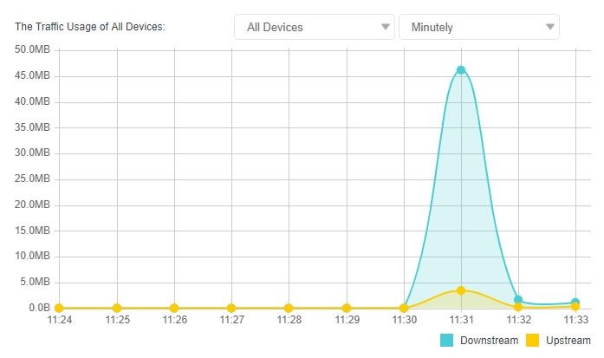
CONT…
NETWORK FLOW OF THE MONTH
In MARCH, the diagnosis stream reports of the internet flow were as below:

Slide 18
CONT….
WEBSITE UPDATES
In the month of March we also managed to update the organization’s website getting to revive our web mails. We were able to back up the so far made changes on the website. New updates were also made on the Gender and Health screen on the website. Our website address still reads www.stadakenya.org.
FIELD WORK AND CONSULTANCY
As a department, we managed to take part in the pre-visit at Ojere Primary and Junior Secondary School for proposed Toilet and Hand washing Station.

Slide 19
CONT….
As a cross-cutting department, we managed to answer relevant ICT questions from different departments so as to better Technology communications and flow of work in the organization. We updated the Pump repair reporting template and also drafted the Near- Miss Report form.
Departments we interacted with in the month of March includes:
M&E Department
Health and Hygiene Department
Drilling Department
Communication Department
Health Department

Slide 20
MONITORING AND EVALUATION DEPARTMENT
The following are the activities conducted by the Monitoring and Evaluation department in March:
Commemorated International Women’s Day at Kibarwa evacuation center with women from Kandaria and Kabonyo Fisheries, highlighting the consequences of climate change and promoting women's economic empowerment.
Celebrated the World Water Day at Rongo Comprehensive School, whose theme was “Water for peace”
Grant writing on: The IHE Delft’s Water and Development Partnership Program, Grant Cycle for Youth-led Organizations working on Climate Change, Loss and damage which was based on Ogenya IDP camp relocation and resettlement and Better World Books Literacy Grant.

Slide 21
CONT….
Attended a Safeguarding Awareness Training Workshop organized by the Christian Aid Foundation alongside NairoBits, at Good Samaritan Hotel, Kisumu.
Compiled borehole drilling requests, and formulated a monthly workplan for the two machines.
Compilation of departmental monthly reports.
Attended the Terms of Reference presentation for the Kisumu Country Gender Sector Working Group, that is to be amended then shared to the partners.

Slide 22
THANK YOU
EMAIL: info@stadakenya.org
Contact: 0705540012
Website: www.stadakenya.org

